Slide 1
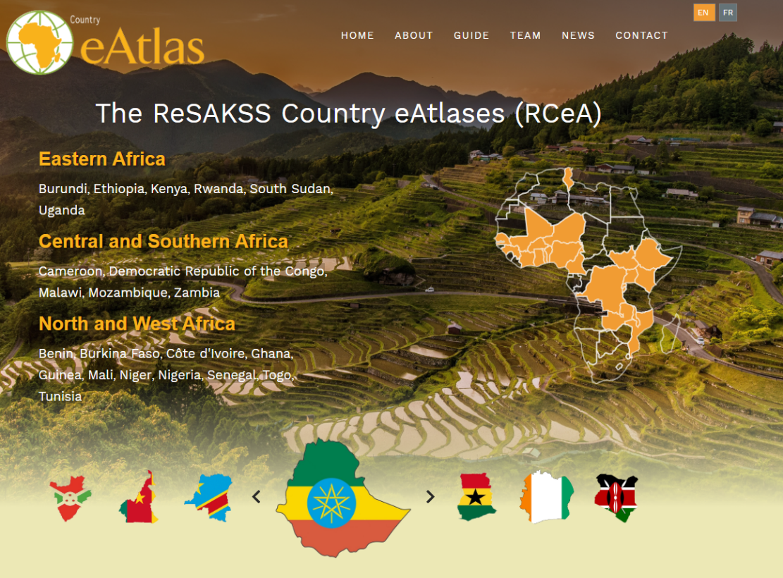
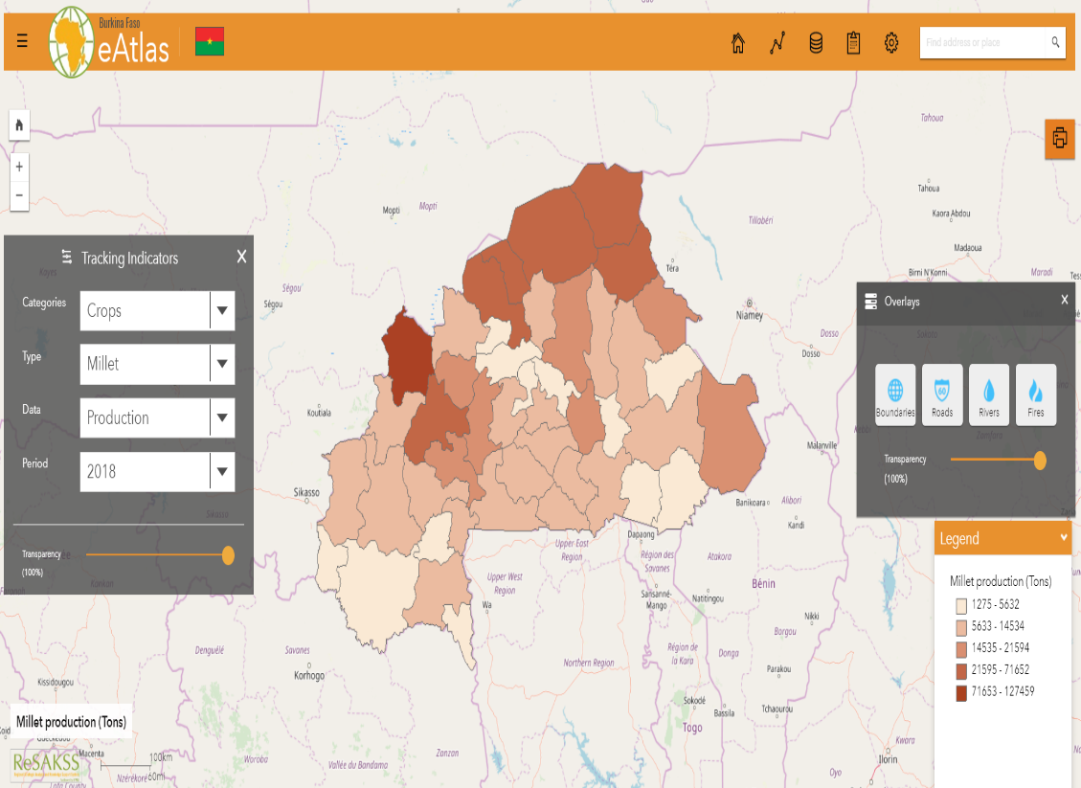
The ReSAKSS Country eAtlases (RCeA) User’s Manual
“The RCeA is a GIS-based data exploration platform designed to help policy analysts and policymakers access and use high quality and highly disaggregated data on agricultural, socio-economic and bio-physical indicators to guide agricultural policy and investment decisions.”
ReSAKSS Country eAtlases

Slide 2
Operating the « ReSAKSS Country eAtlases » platform
The ReSAKSS Country eAtlases (RCeA) is an advanced data exploration system designed to support evidence-based policy planning and implementation, and inclusive policy review and learning processes in African countries.
The system is an important tool for policymakers, researchers and other stakeholders. Some of its objectives are :
To provide an online, highly interactive and dynamic data environment rich with standard pre-processing and essential data analysis tools.
To ensure broad access to high quality data to facilitate inclusive review and dialogue processes.
This tutorial aims to describe the different steps to easily navigate in the platform. Burkina Faso will serve as an example to illustrate the use of the RCeA. This example may be duplicated for all the 21 other countries.

Slide 3
Platform landing page
Use your web browser to access the RCeA platform: http://eatlas.resakss.org/
Below is, the RCeA landing page with its different menus : Home, About, Guide , Team, News and Contact .
There are three ways to access a country eAtlas:
By the country name
Through the Africa map
Via the country flag
We will explore Burkina Faso eAtlas as an example.

Slide 4
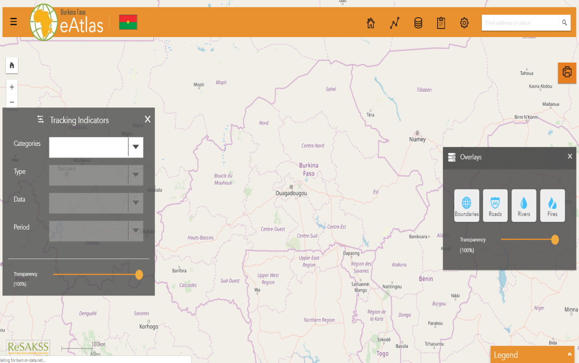
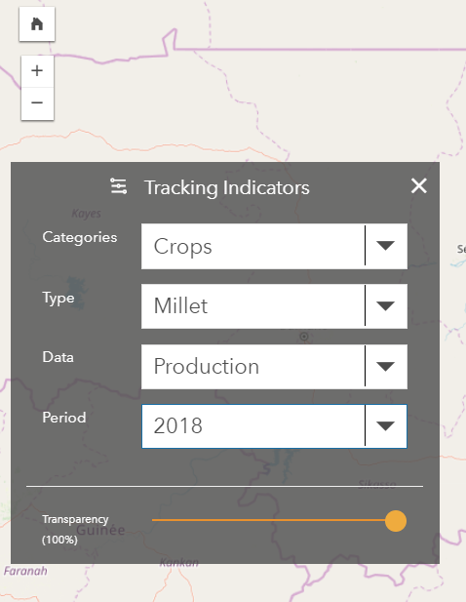
Burkina Faso eAtlas
Maps
This page serves as a basis for all requests to be made in the eAtlas.
On the left of the interface, a window allows to display the maps for the different indicators at various times.

Slide 5
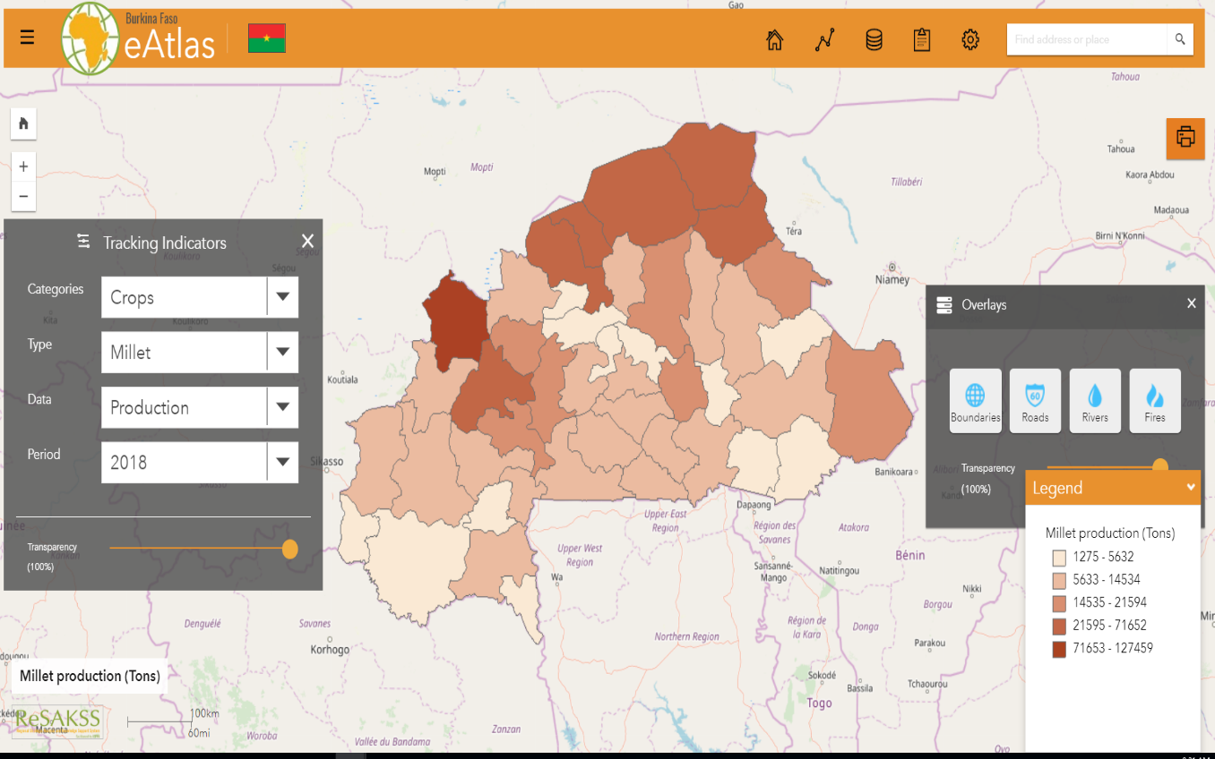
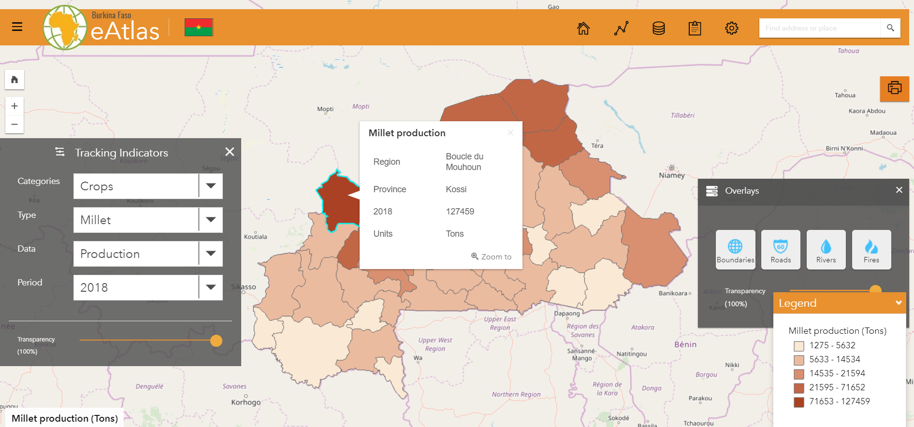
For example, to display millet production map in 2018, follow the steps below :
Under Categories ,click on Crops,
Under Type, choose the type of crop(Millet here),
Under Data, select the data (Production here)
And under Period, choose a year (2018 here) . Below is the result:
The legend is visible at the bottom right corner of the page.
You can click on a specific Burkina Faso province to get the corresponding Millet production in that region.

Slide 6
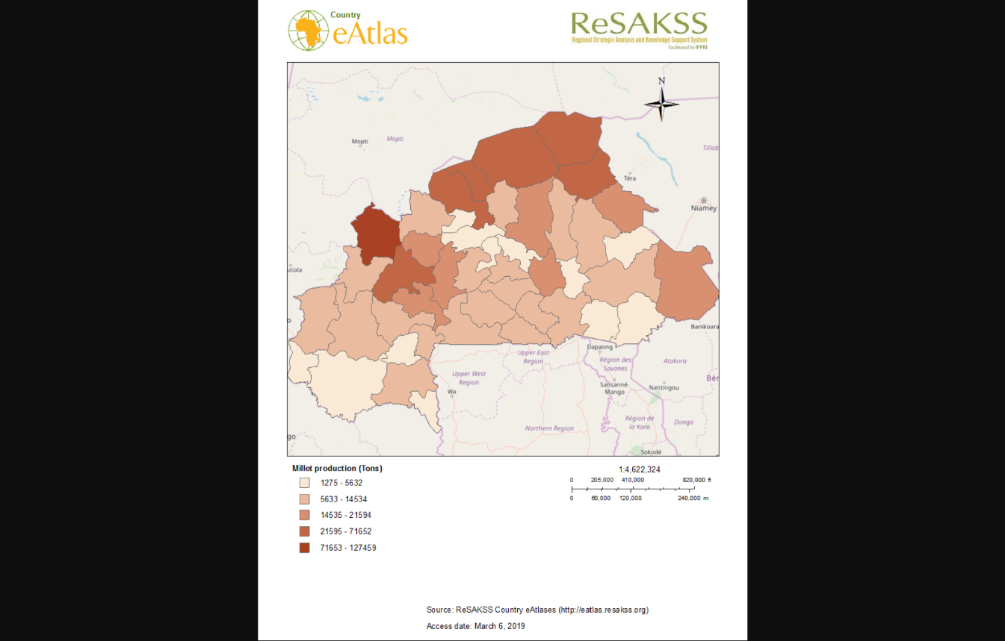
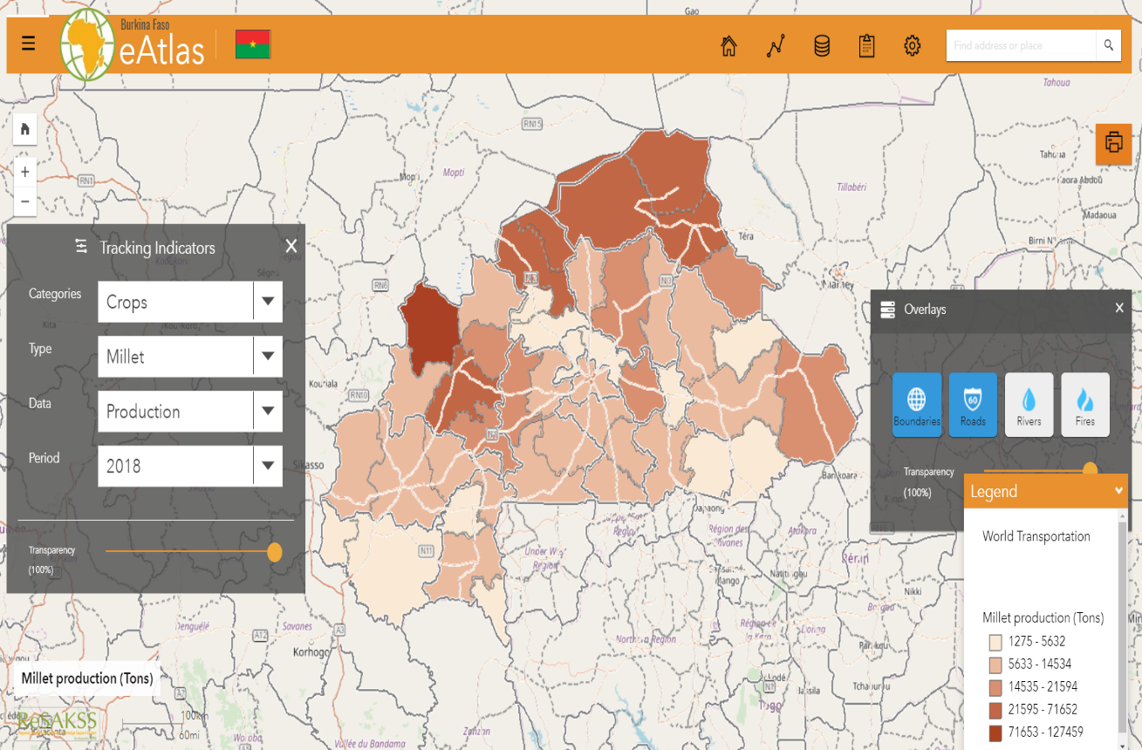
Printing tool
This option allows you to save a map for printing or integration into a document.
Layers overlay
This option allows layers to be superimposed on the maps. Layers available for layering are : boundaries, roads, rivers and fires.
Below is an overlay with boundaries and roads .

Slide 7
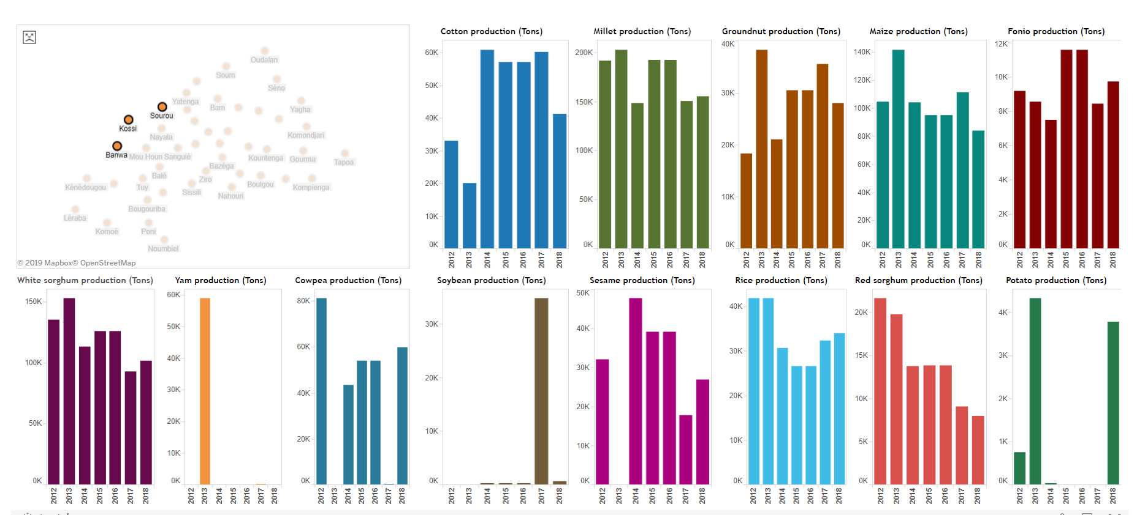
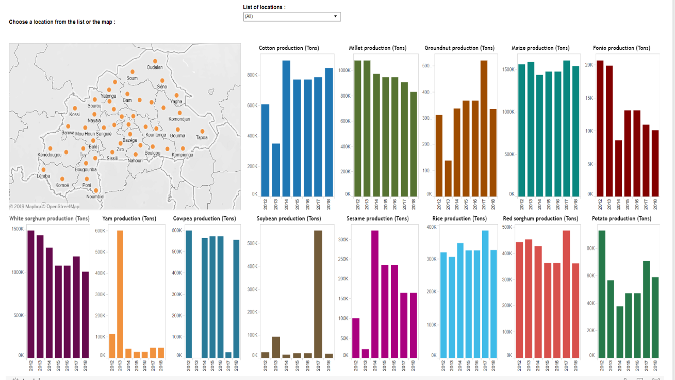
Analytics
Clicking on the « Analytics » tab allows to access to the selected indicator analysis. In the following example :
Click on Analytics,
Select Crops
After clicking on Production Analysis, you will access the analytics graphics :
The following image highlights the evolution of agricultural production in selected provinces (Banwa, Kossi and Sourou) over a seven-year period.

Slide 8
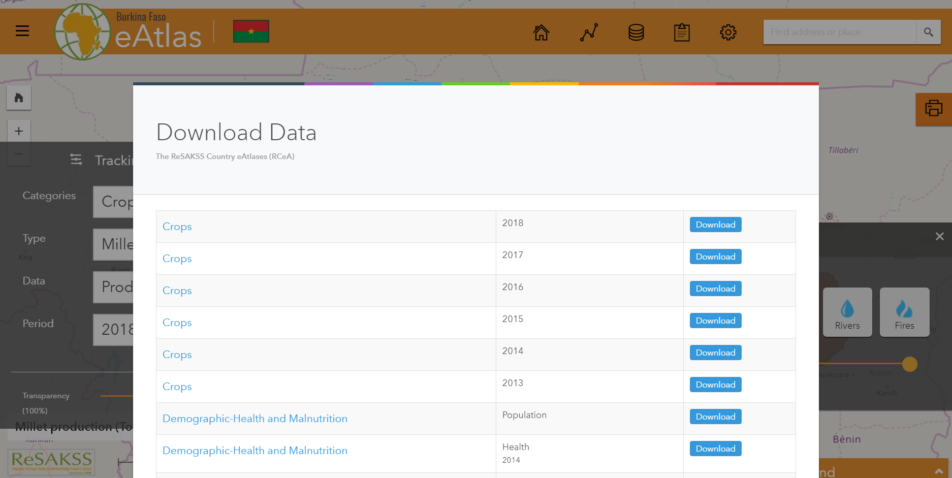
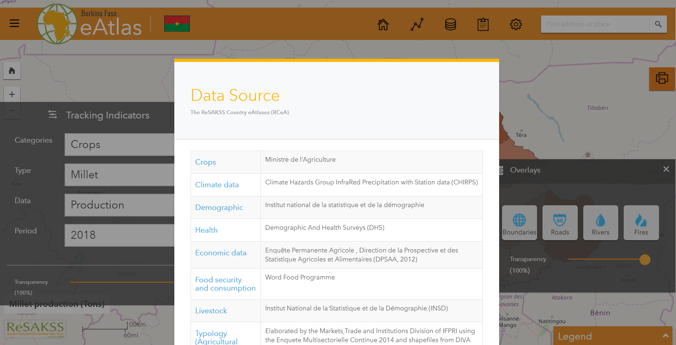
Download
This option allows to download all available data in the eAtlas ( Excel tables of raw data, shapefiles). These data are packaged in a ZIP folder. They can be decompressed , after download, with a data compression software like WinRAR or WinZip.
Source
This option provides the source of all the data in the eAtlas.

Slide 9
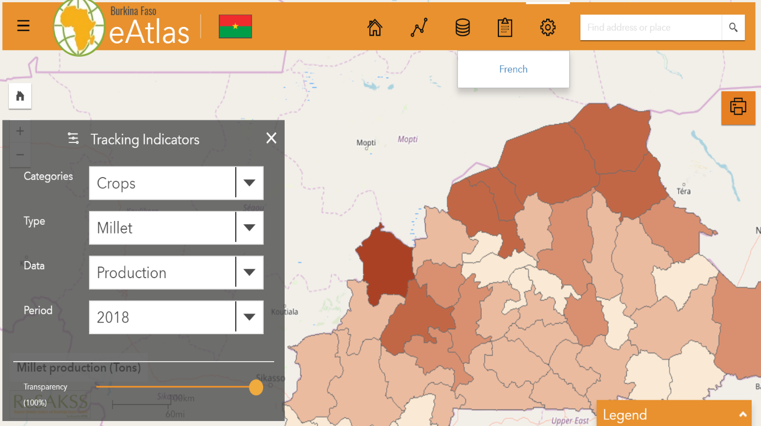
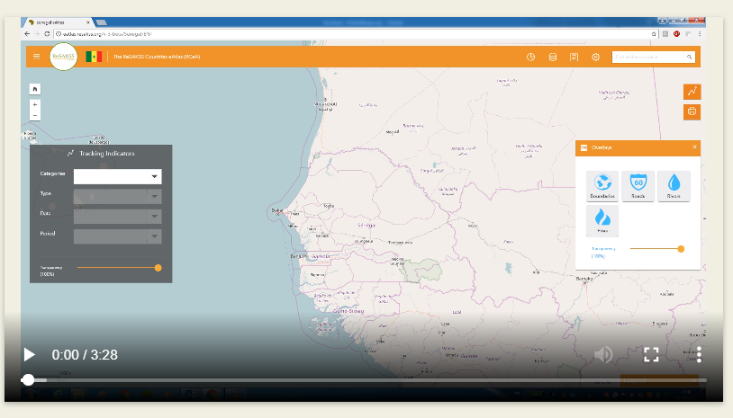
Language
This option allows you to change the language of the eAtlas.
The French-speaking countries have a version in French and Portuguese-speaking countries have a Portuguese version in addition to an English eAtlas available for all countries.
Video tutorial
The video below is a guide for the use of the ReSAKSS Country eAtlases. Click on the Play button to start.

